Slide 1
THIS PPT IS FOR REFERENCE ONLY. PLEASE REFER BOOK FOR DETAILED STUDY

Slide 2
UNIT-III
Design of FIR Filter

Slide 3
FIR filter are called as non recursive filters because they don’t use the feedback.

Slide 4
Sr. No. | IIR systems | FIR systems
1. | IIR stands for infinite impulse response systems | FIR stands for finite impulse response systems
2. | IIR is Recursive filter with feedback. These are less flexible. | FIR is Non-recursive filter without feedback. More flexibility and ability to finely adjust the response of the system
3. | It cannot implement linear-phase filtering. | It can implement linear-phase filtering.
4. | IIR filter uses current input sample value, past input and output samples to obtain current output sample value. | FIR filter uses only current and past input digital samples to obtain a current output sample value. It does not utilize past output samples.
5. | Simple IIR equation is mention below.,y(n)= b(0)x(n) + b(1)x(n-1) + b(2)x(n-2) + b(3)x(n-3) + a(1)y(n-1) + a(2)y(n-2) + a(3)y(n-3) | Simple FIR equation is mention below. y(n)= h(0)x(n) + h(1)x(n-1) + h(2)x(n-2) + h(3)x(n-3) + h(4)x(n-4)
6. | Transfer function of IIR filter will have both zeros and poles | Transfer function of FIR filter will have only zeros,
7. | IIR filters are not stable as they are recursive in nature and feedback is also involved in the process of calculating output sample values. | FIR filters are preferred due to its linear phase response and also they are non-recursive. Feedback is not involved in FIR, hence they are stable
8. | IIR filter need more power due to more coefficients in the design. | FIR filter consume low power
9. | IIR filters have analog equivalent | FIR have no analog equivalent.
10. | IIR filters are used as notch(band stop),band pass functions. | FIR filters are used as anti-aliasing,low pass and baseband filters
11 | Delay is less than FIR filter. | Delay is more than IIR filter.

Slide 5
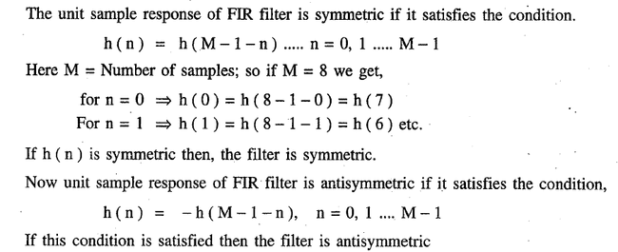

Slide 6
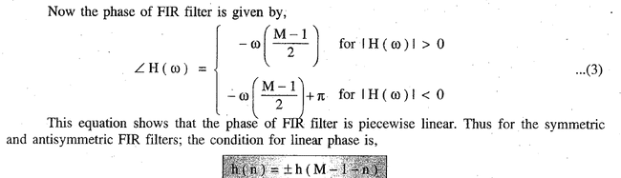

Slide 7
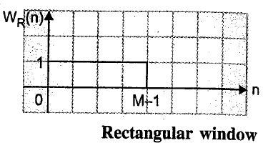
Design of FIR Filter using Windows

Slide 8
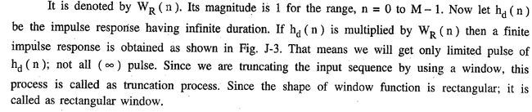

Slide 9
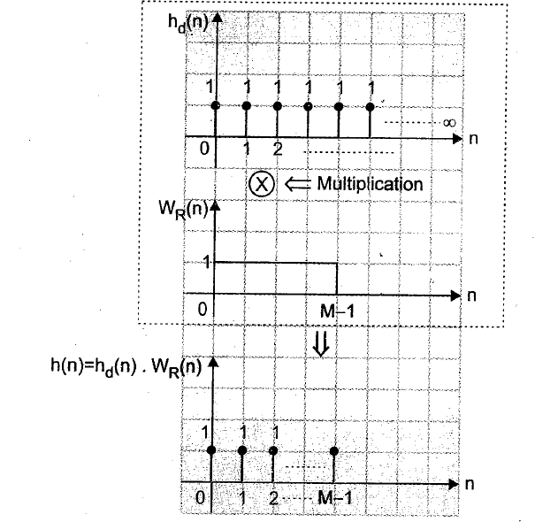
Truncation Process

Slide 10
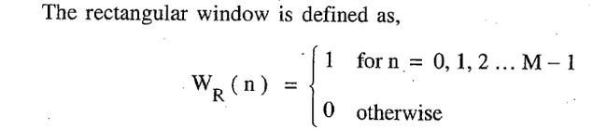

Slide 11
Types of windows in design of FIR Filter
Rectangular Window
Hamming Window
Hanning Window
Blackman Window

Slide 12
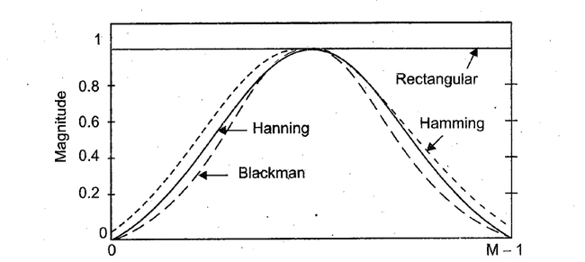

Slide 13
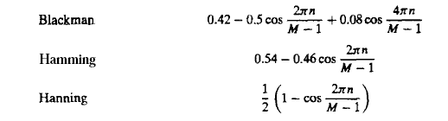

Slide 14
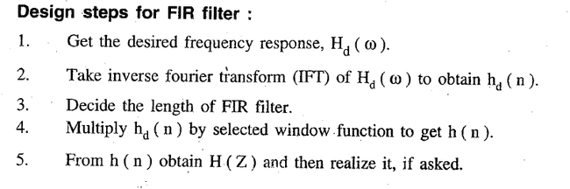

Slide 15
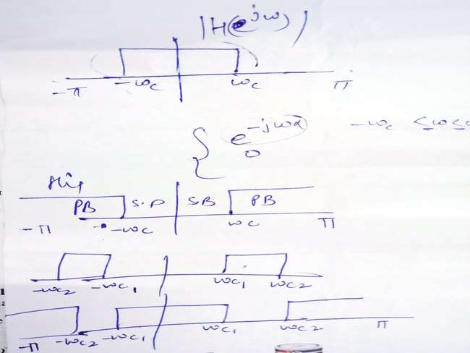
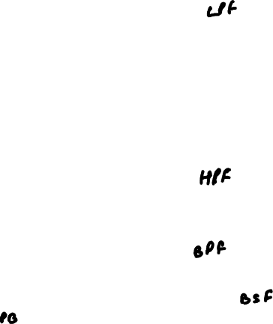

Slide 16
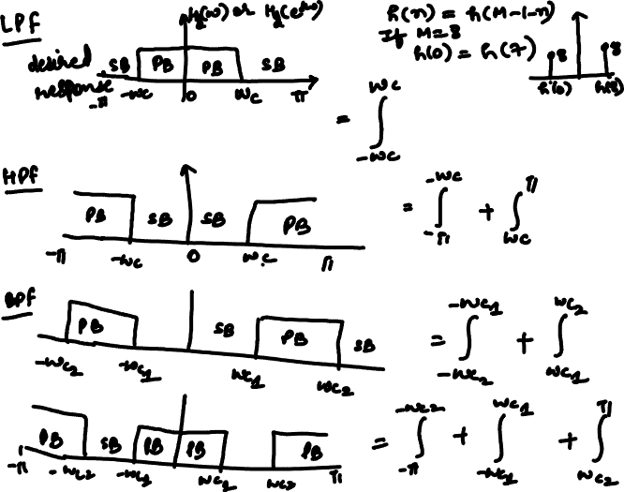

Slide 18
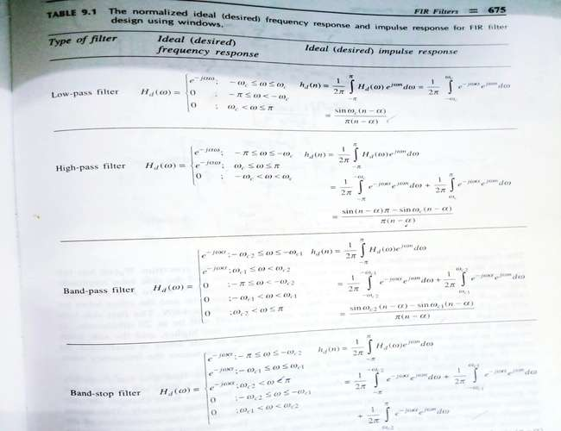

Slide 19
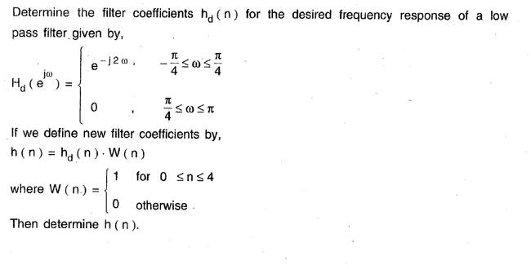

Slide 20
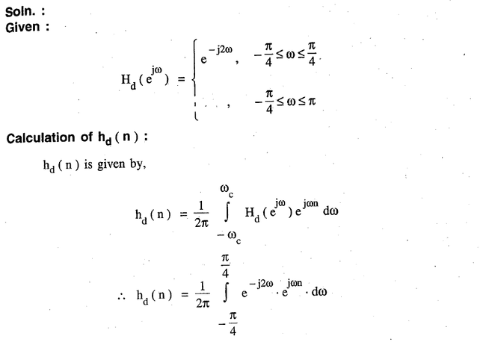

Slide 21
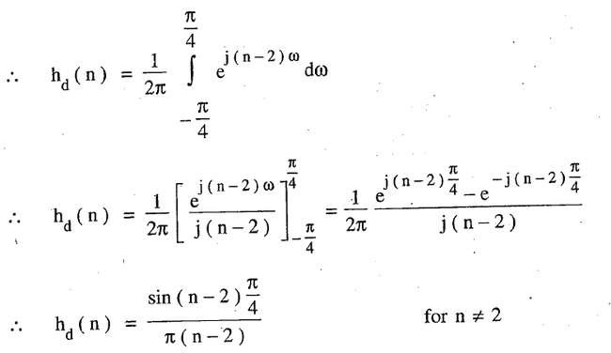

Slide 22
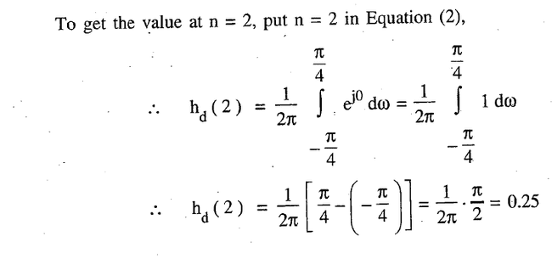

Slide 23
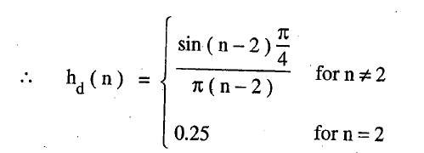

Slide 24
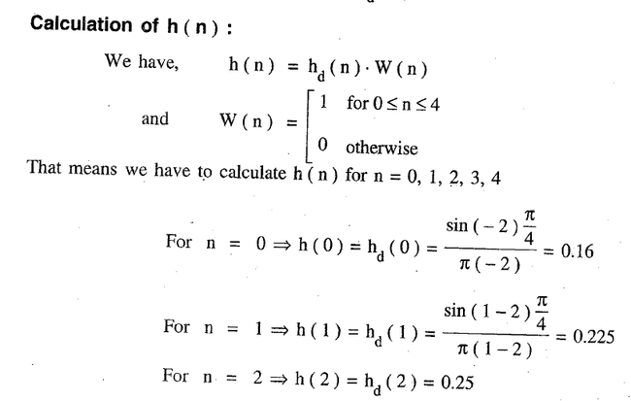

Slide 25
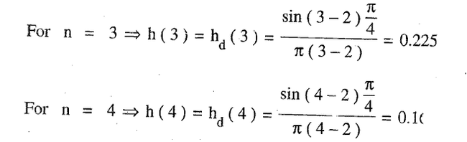

Slide 26
h(0)=h(M-1-n)
h(0)=h(5-1-0)
h(0)=h(4)
h(1)=h(5-1-1)
h(1)=h(3)

Slide 27
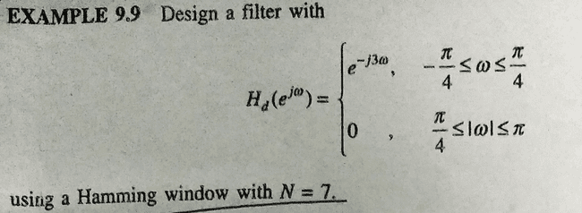

Slide 28
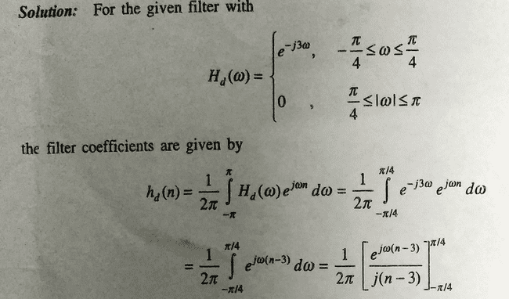

Slide 29
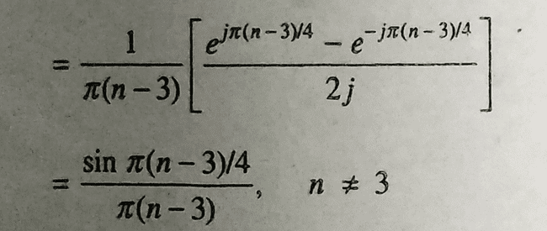

Slide 30
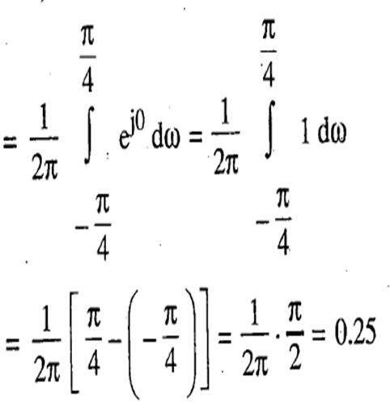
hd(3) at n=3

Slide 31
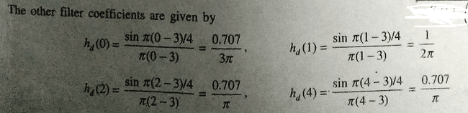

Slide 32
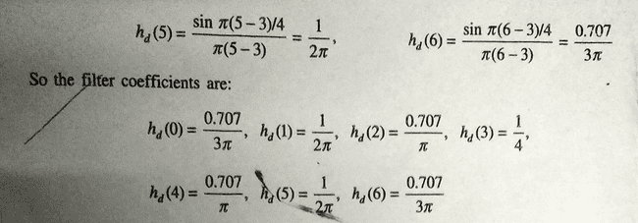

Slide 33
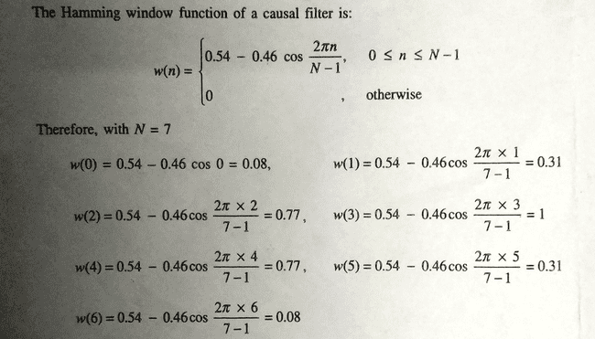

Slide 34
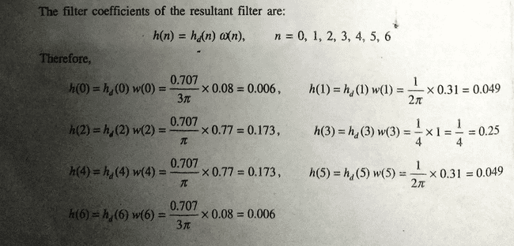

Slide 35
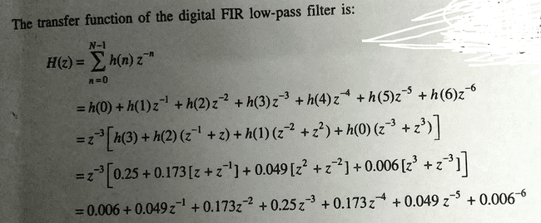

Slide 36
FIR filters ________
A. are non-recursive
B. do not adopt any feedback
C. are recursive
D. use feedback
a. A & B
b. C & D
c. A & D
d. B & C

Slide 37
Which of the following defines the rectangular window function of length M-1?
a)w(n)=1, n=0,1,2...M-1
=0, else where
b)w(n)=1, n=0,1,2...M-1
=-1, else where
c)w(n)=0, n=0,1,2...M-1
=1, else where
d) None of the mentioned

